Slide 1

Linear Regression

Slide 2
Contents
Supervised learning
What is linear regression?
Step by step calculation of linear regression

Slide 3
Recap question-1
Do you know the difference between supervised learning and unsupervised learning?

Slide 4
Recap question-2
Do you know the difference between the classification and regression (function approximation) problems in Machine Learning?

Slide 5

Recap question-3
Is Regression a supervised or unsupervised learning problem?

Slide 6
Recap question-4
Is Regression a classification or function approximation problem?

Slide 7
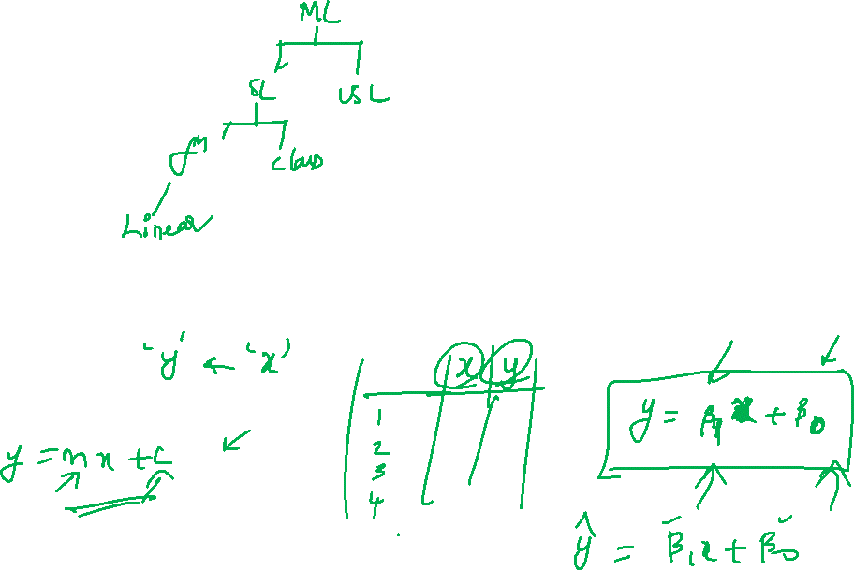
Linear regression

Slide 8
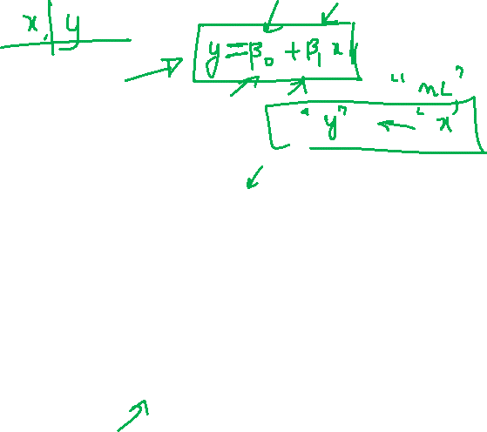
Plan for Linear regression
Introduction to regression
Linear regression Model form
Parameters estimation
Formulation of Linear regression problem
Model fitting
General approach
Problem statement
Validation and modification

Slide 9
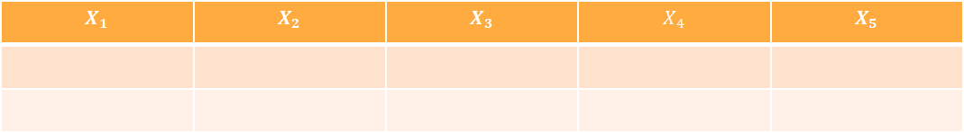
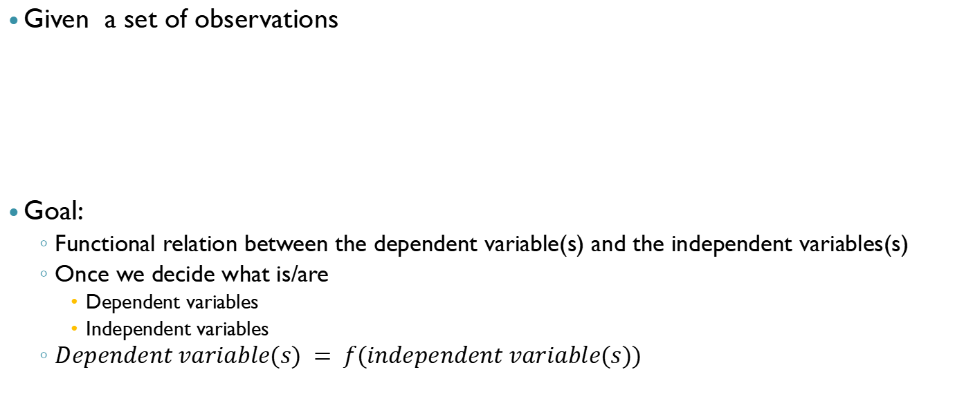
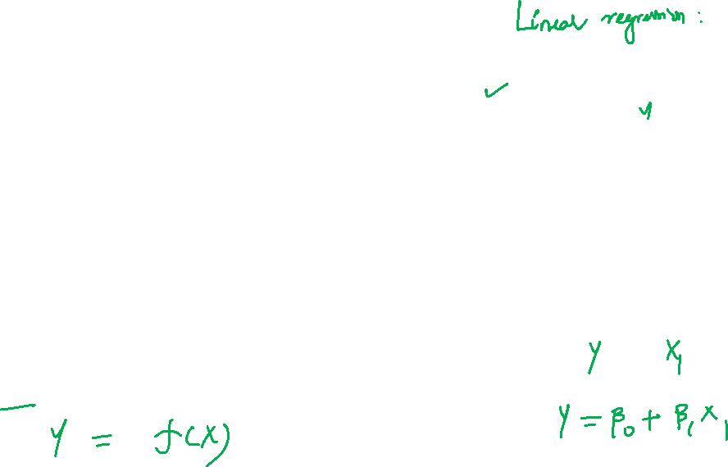
What is Regression?
Given a set of observations
Goal:
Functional relation between the dependent variable(s) and the independent variables(s)
Once we decide what is/are
Dependent variables
Independent variables
$Dependent variable(s) = f(independent variable(s))$
$$X_{1}$$ | $$X_{2}$$ | $$X_{3}$$ | $$X_{4}$$ | $$X_{5}$$

Slide 10
Motivation
Use case Examples
Business
Example: Insurance companies would like to understand the association between healthcare costs and ageing (Can be used to fix the premium rates)
Engineering
Example: Can we infer difficult to measure properties of a product from other easily measured variables? (mechanical strength of a polymer from temperature, viscosity or other process variables) – also known as a soft sensor

Slide 11
Regression is a supervised learning technique
Regression is one of the most popular supervised learning algorithms in predictive analytics.
A regression model requires the knowledge of both the
Outcome(s) and the
feature variable(s) in the data

Slide 12
Notations
Dependent variable(s)
Denoted by $Y_{1},Y_{2}…Y_{n}$
Denoted by 𝑌_1,𝑌_2…𝑌_𝑛
Each of these $Y_{i}$ can be of size $m×1$
Each of these 𝑌_𝑖 can be of size 𝑚×1
They are also known as Response variables, Regressands, Predicted variables or output variables
Independent variables(s)
Denoted by $X_{1},X_{2}…X_{n}$
Denoted by 𝑋_1,𝑋_2…𝑋_𝑛
Each of these $X_{i}$ can be of size $m×1$
Each of these 𝑋_𝑖 can be of size 𝑚×1
They are also known as Predictor variables, Regressors, Explanatory variables, input variables or features

Slide 13
Classification of regression problems
Regression problems
Nature of relationship
Linear
Non-linear
Number of dependent and independent variables
Univariate
One dependent and One independent
Multivariate
Multiple dependent and Multiple independent

Slide 14
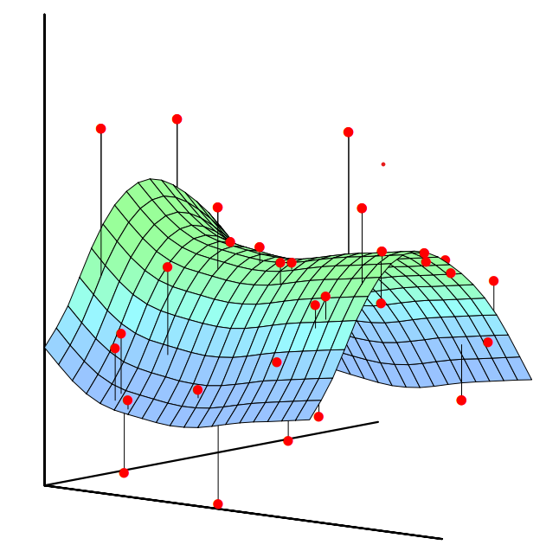
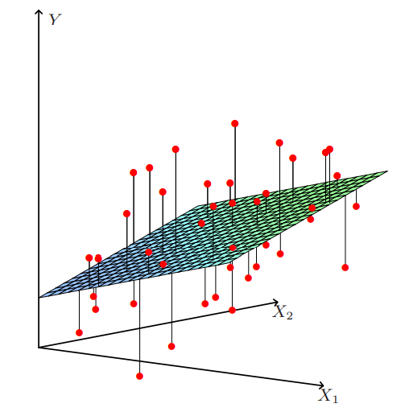
Linear and non-linear regression (geometric perspective)

Slide 15
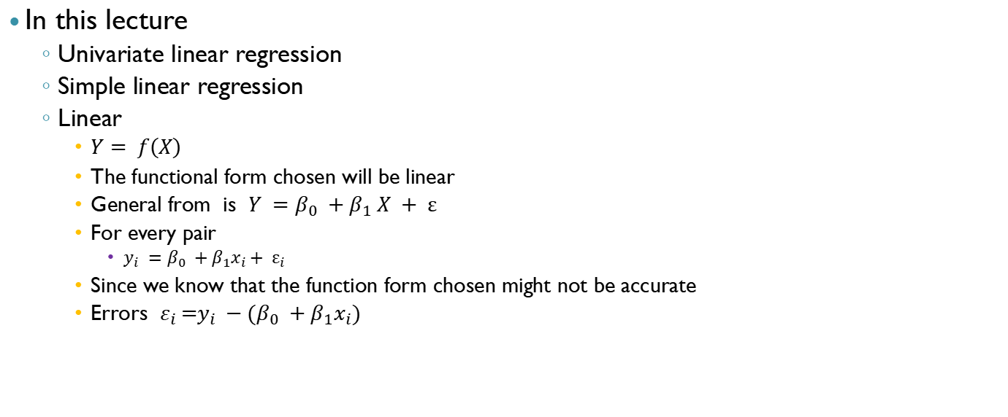
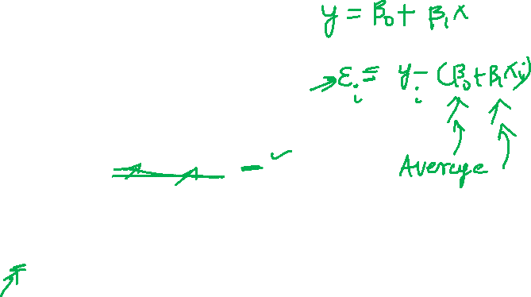
Focus: Simple Linear regression
In this lecture
Univariate linear regression
Simple linear regression
Linear
$Y= f\left(X\right)$
The functional form chosen will be linear
General from is $Y =β_{0} +β_{1} X + ε$
For every pair
$y_{i} =β_{0} +β_{1}x_{i}+ ε_{i}$
Since we know that the function form chosen might not be accurate
Errors $ε_{i} \text{=}y_{i} −(β_{0} +β_{1}x_{i})$
X | Y

Slide 16
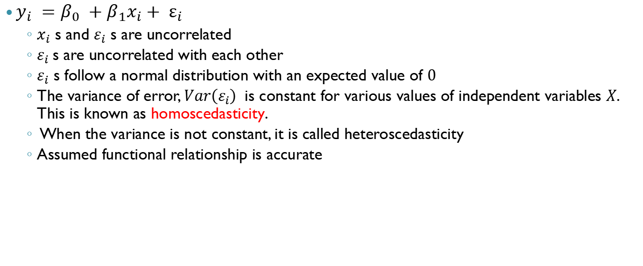
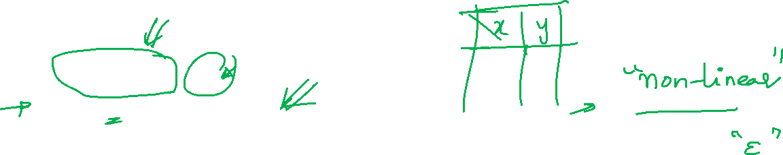
Assumptions
$y_{i} =β_{0} +β_{1}x_{i}+ ε_{i}$
$x_{i}$ s and $ε_{i}$ s are uncorrelated
$ε_{i}$s are uncorrelated with each other
$ε_{i}$ s follow a normal distribution with an expected value of $0$
The variance of error, $Var\left(ε_{i}\right)$ is constant for various values of independent variables $X$. This is known as homoscedasticity.
When the variance is not constant, it is called heteroscedasticity
Assumed functional relationship is accurate

Slide 17
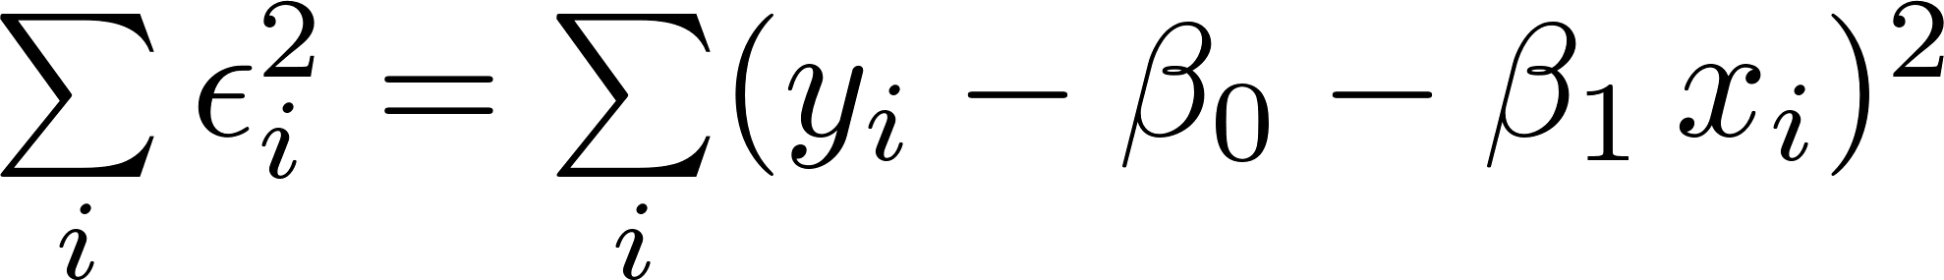
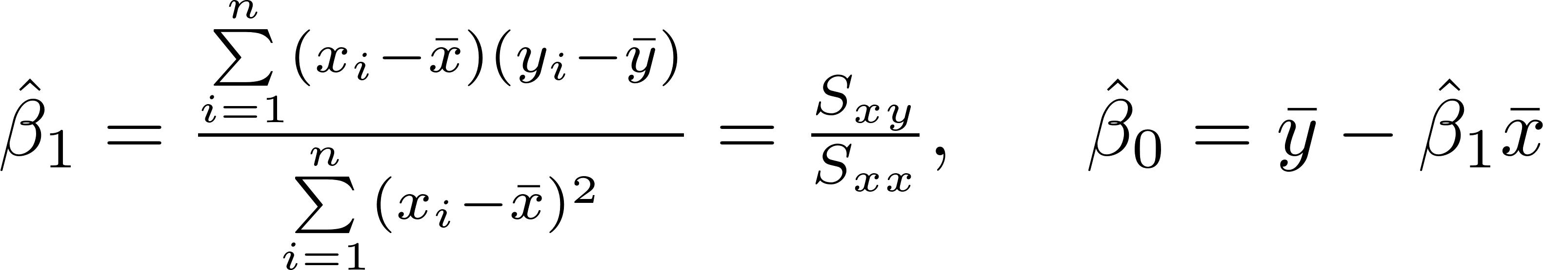
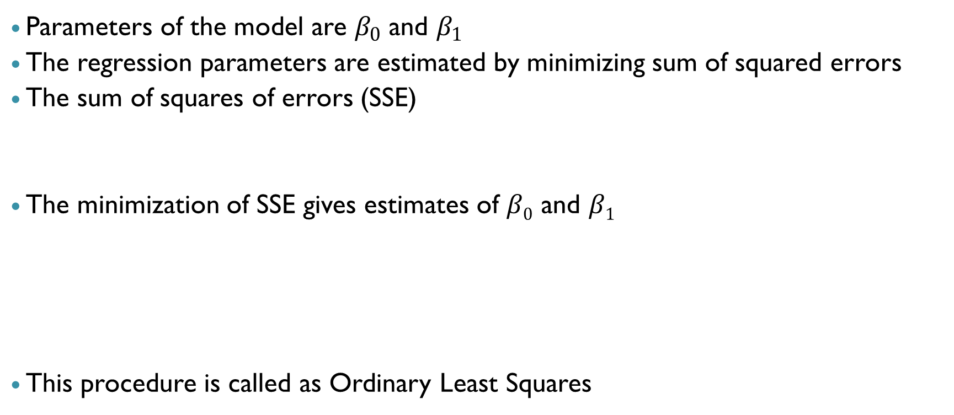
Parameters of the model
Parameters of the model are $β_{0}$ and $β_{1}$
The regression parameters are estimated by minimizing sum of squared errors
The sum of squares of errors (SSE)
The minimization of SSE gives estimates of $β0$ and $β1$
This procedure is called as Ordinary Least Squares

Slide 18
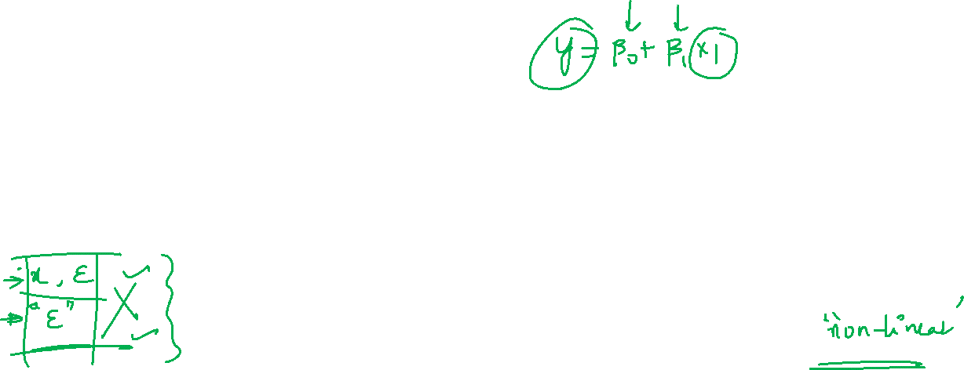

General procedure (regression)
Start
Choose a set of variables, form of model, method of fitting, Specific assumptions
Formulate the Problem
Fit the Model
Use method of fitting
Validate Assumptions
Residual plots, Outliers detection, Sensitivity analysis
No
OK?
Yes
Evaluate Fitted Model
Goodness of fit tests
No
Yes
Stop
OK?
Use the model for the intended purpose

Slide 19
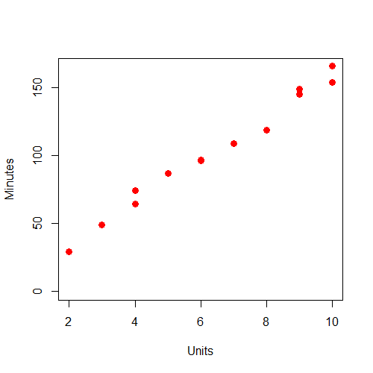
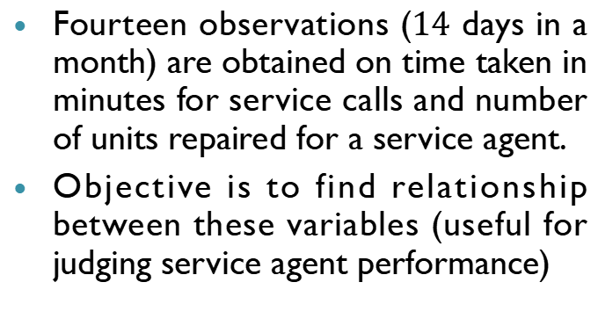
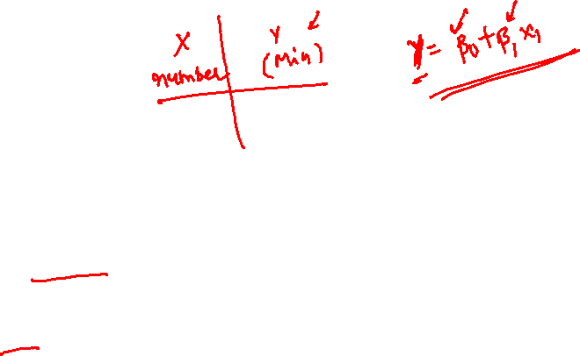
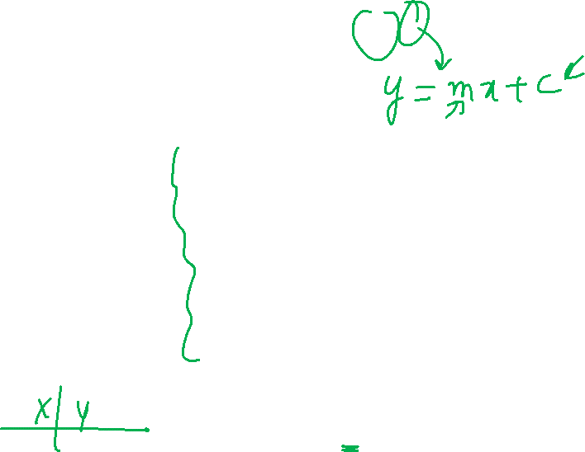
Example problem
Fourteen observations ($14$ days in a month) are obtained on time taken in minutes for service calls and number of units repaired for a service agent.
Objective is to find relationship between these variables (useful for judging service agent performance)

Slide 20
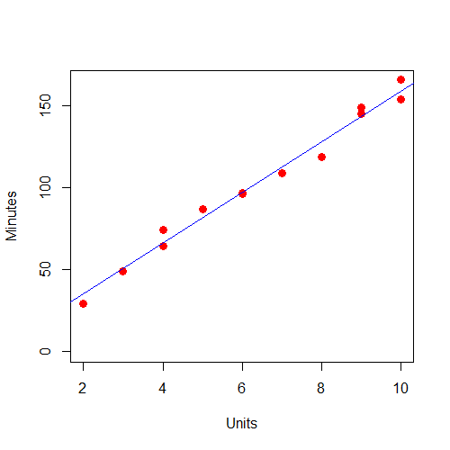
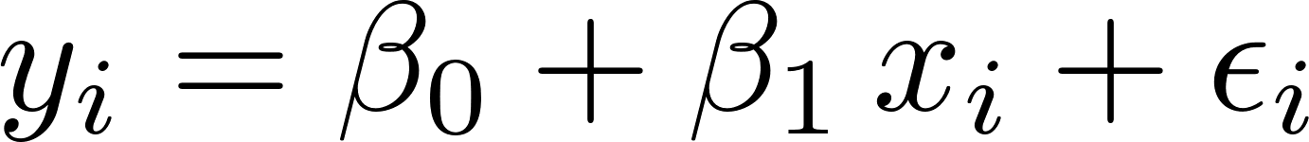

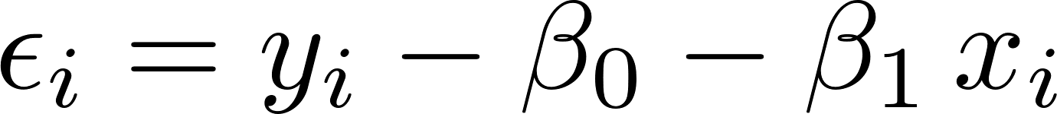
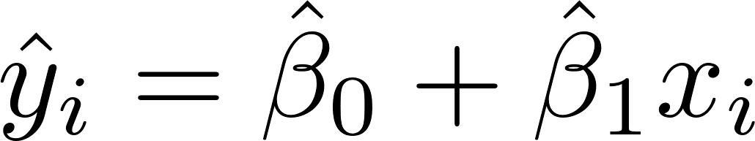
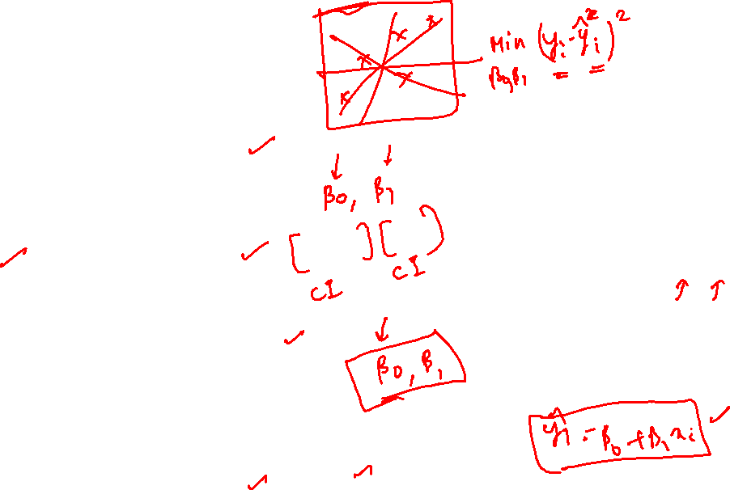
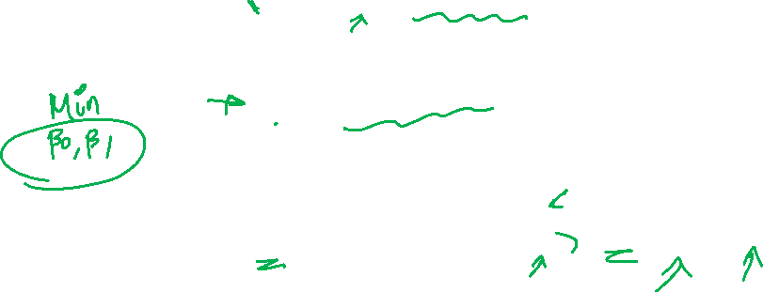

Ordinary Least Squares (OLS)
Linear model between y_{i} and x_{i} , i = 1,…, n
Error in only dependent variable and
no error in independent variable:
The sum of squares of errors (SSE)
The minimization of SSE gives estimates of $β0$ and $β1$

Slide 21
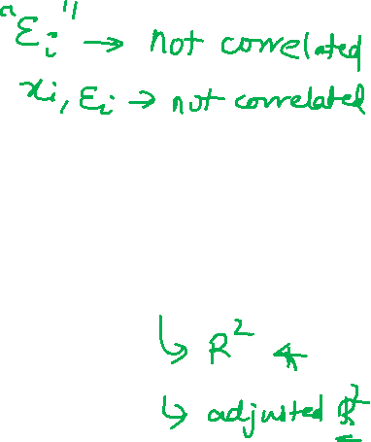
MODEL ASSESSMENT

Slide 22
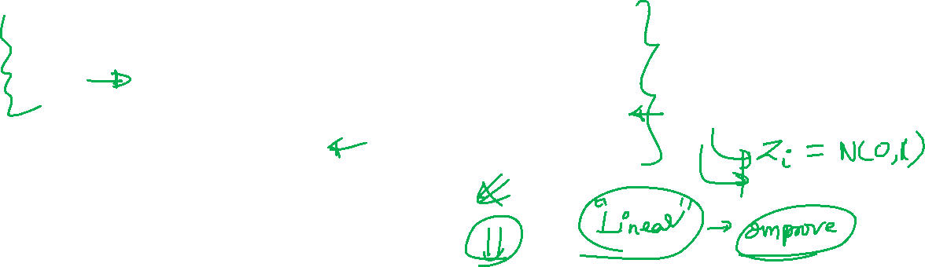
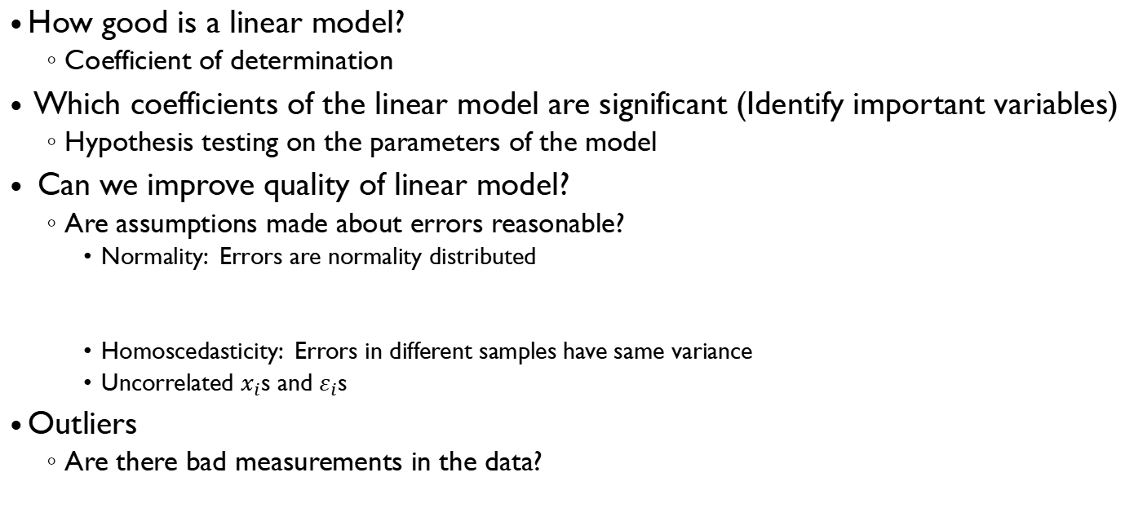
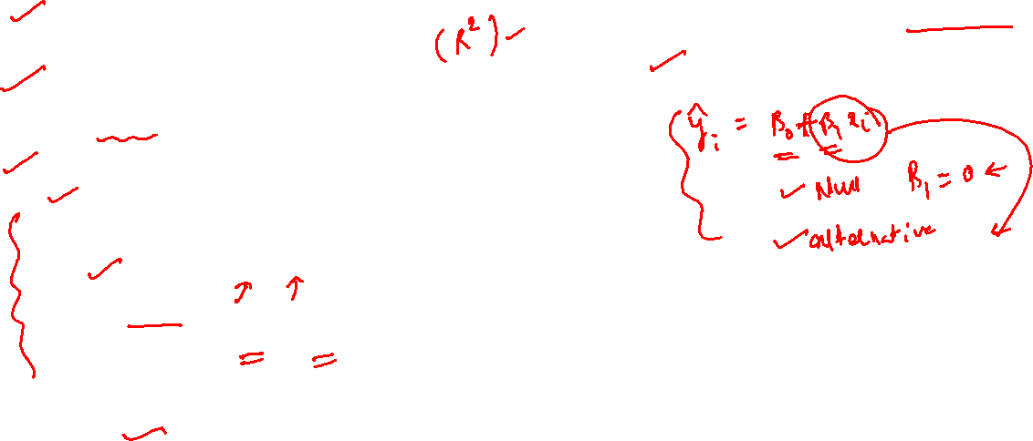
Model assessment and improvement
How good is a linear model?
Coefficient of determination
Which coefficients of the linear model are significant (Identify important variables)
Hypothesis testing on the parameters of the model
Can we improve quality of linear model?
Are assumptions made about errors reasonable?
Normality: Errors are normality distributed
Homoscedasticity: Errors in different samples have same variance
Uncorrelated $x_{i}$s and $ε_{i}$s
Outliers
Are there bad measurements in the data?

Slide 23
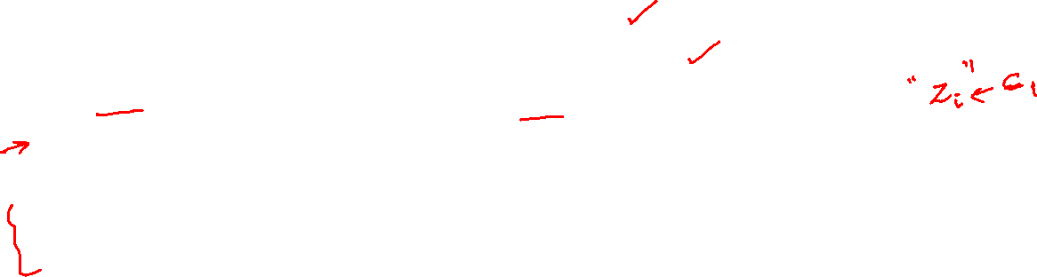
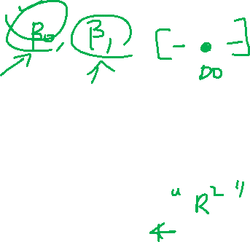
Model diagnostics
The following measures are used to validate the simple linear regression models
Co-efficient of determination (R-squared)
Hypothesis test for the regression coefficient
Residual analysis to validate the regression model assumptions
Outlier analysis, since the presence of outliers can significantly impact the regression parameters
Analysis of variance for overall model validity (important for multiple linear regression)

Slide 24
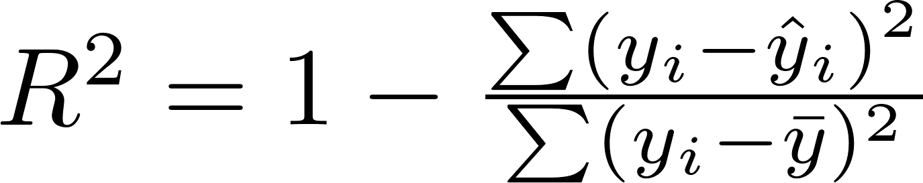
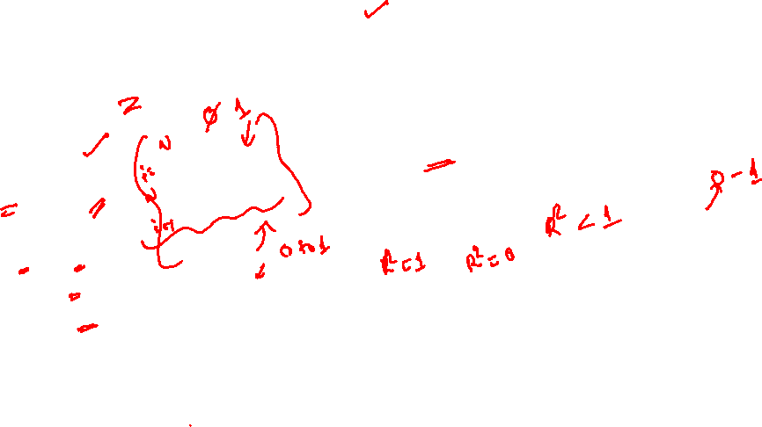
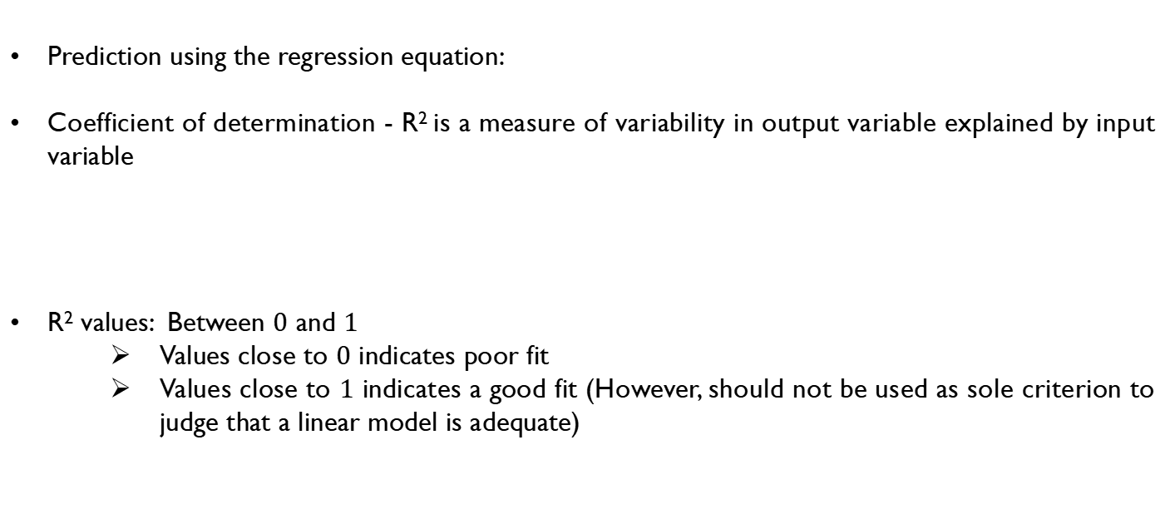
Coefficient of determination (R-squared)
Prediction using the regression equation:
Coefficient of determination - R² is a measure of variability in output variable explained by input variable
R² values: Between $0$ and $1$
Values close to $0$ indicates poor fit
Values close to $1$ indicates a good fit (However, should not be used as sole criterion to judge that a linear model is adequate)
Variability explained by
Total variability in y

Slide 25
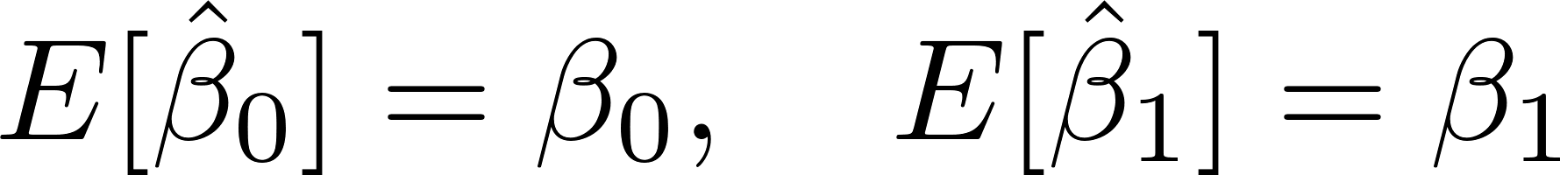
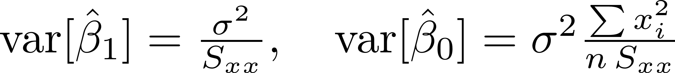
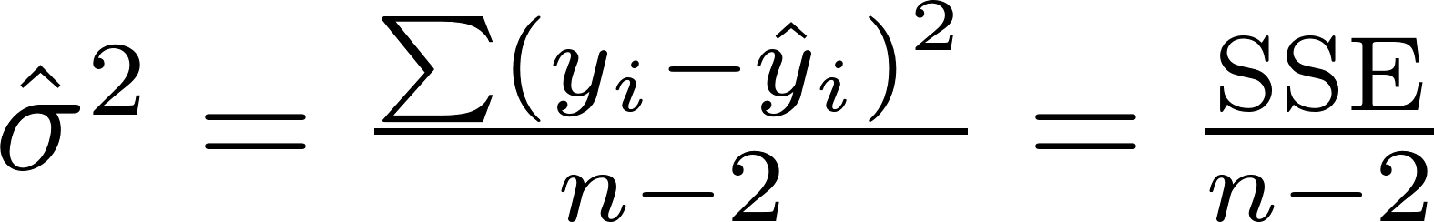
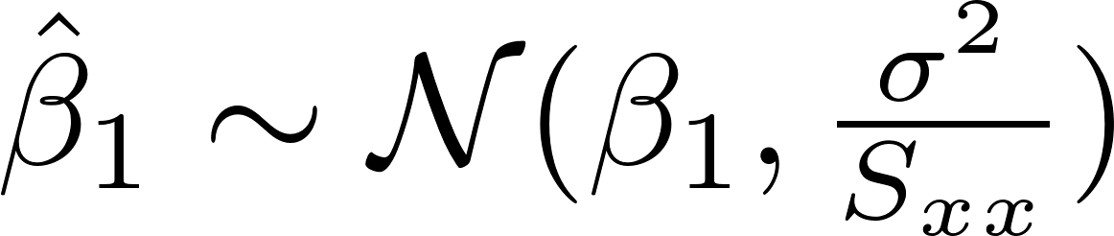
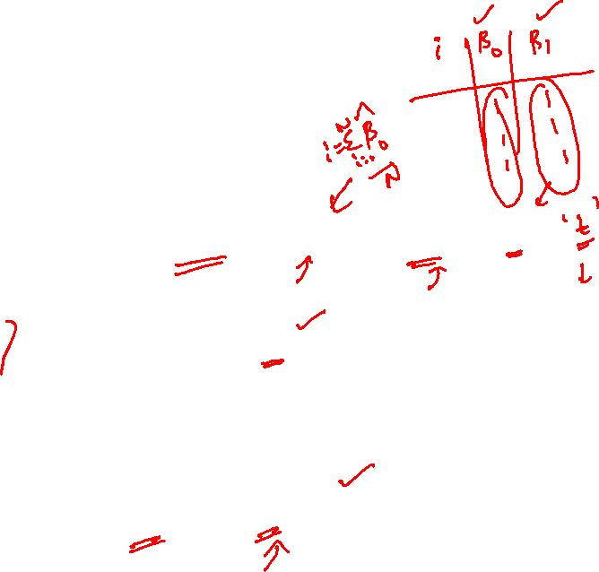

Significance test on model parameters
Both ${\hat{β}}_{0}$ and ${\hat{β}}_{1}$estimates are unbiased
Variance of the estimates
Estimate of σ²
Distribution of slope estimate

Slide 26
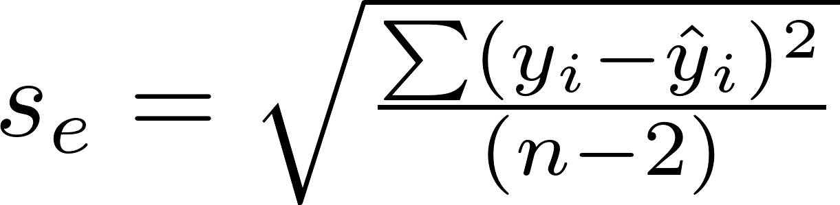
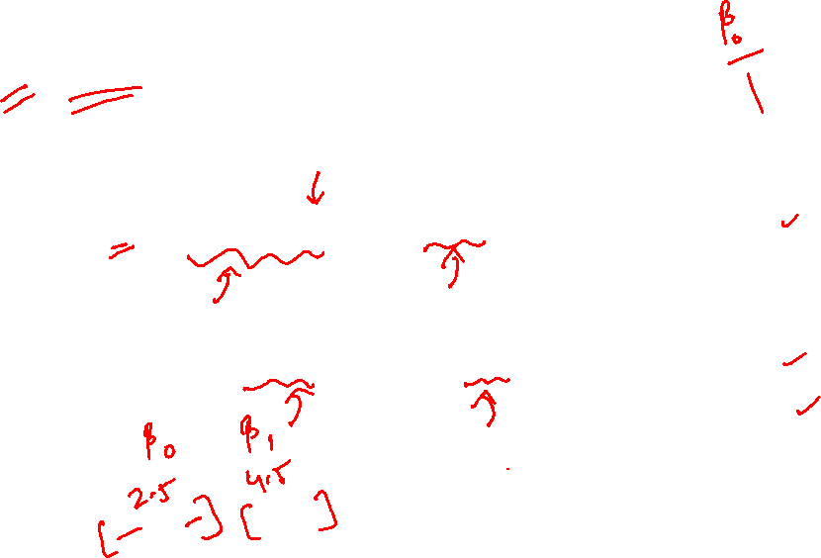

Confidence Intervals on regression coefficients
95% two-sided confidence intervals (CI) for ${\hat{β}}_{0}$ and ${\hat{β}}_{1}$
t_{0.025,12}

Slide 27
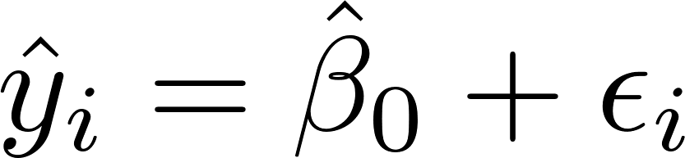
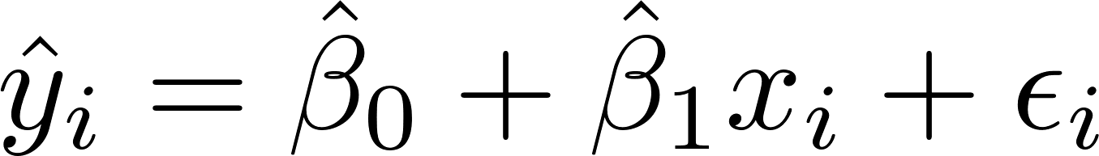
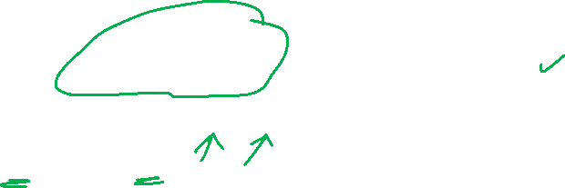
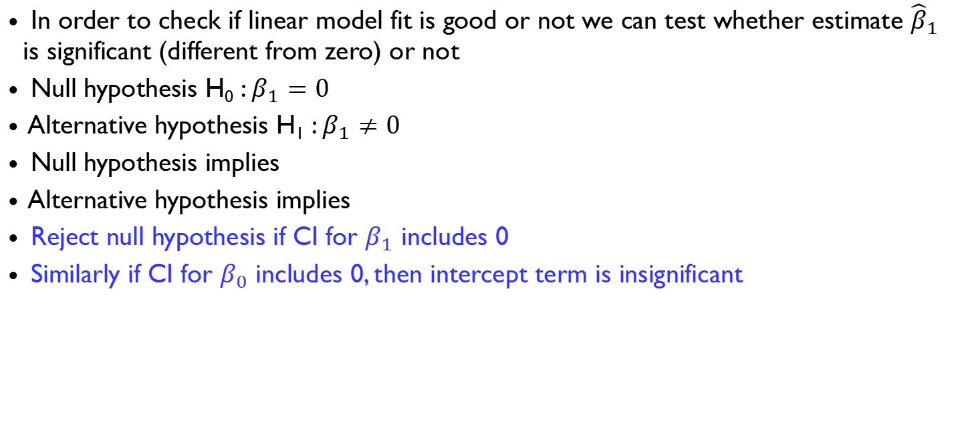
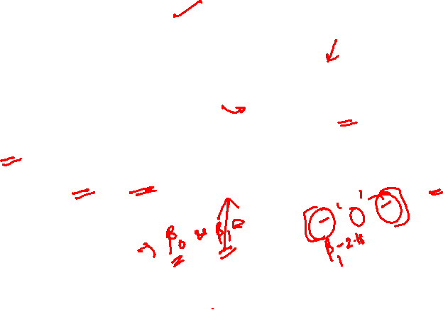
Hypothesis test on the significance of the parameters
In order to check if linear model fit is good or not we can test whether estimate ${\hat{β}}_{1}$ is significant (different from zero) or not
Null hypothesis H₀ : $β_{1}=0$
Alternative hypothesis H₁ : $β_{1}≠0$
Null hypothesis implies
Alternative hypothesis implies
Reject null hypothesis if CI for $β_{1}$ includes 0
Similarly if CI for $β_{0}$ includes 0, then intercept term is insignificant
Reduced Model
Full Model

Slide 28
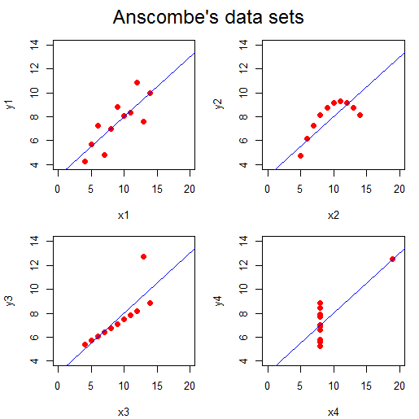






OLS: Anscombe’s data
Got a regression equation from data: Job done?
Anscombe’s (1973) data sets:
Output of any programme is the end of beginning
Need an analysis for fitting an appropriate model
Notes:
Plz talk about it

Slide 29

OLS: Model Diagnostics
Questions:
Does the underlying data satisfy the assumptions?
Data are free of outliers?
Do some observations exert more influence than others?
Can the regression equation be improved by using a nonlinear model?
Notes:
Plz talk about it

Slide 30

OLS: Residual plots
A straightforward method for validation of a model:
Residual plots
Properties of ordinary least squares residuals
Notes:
Plz talk about it

Slide 31



OLS: Residual plots
Standardized residual:
Notes:
Plz talk about it

Slide 32


OLS: Residual Plots
Residual plots: Standardized residuals for assessing
Validity of the linear model
Normality of the residuals
Homoscedastic vs heteroscedastic errors
Correlated vs uncorrelated errors
Notes:
Plz talk about it

Slide 33





Validity of model and correlation between errors and $x_{i}$s
Residual plots: OLS residuals for Anscombe’s data
Look for patterns
No pattern: A valid model
Pattern: Not a valid model
Shape of Pattern
Information on the function of $X$
Pattern
No pattern
Pattern
Pattern
Notes:
Plz talk about it

Slide 34

Normal Q-Q Plot
Plot of sample quantiles against quantiles from normal distribution
Quantile (or percentile) is the data value below which a certain percentage of data lies
Quantiles for a standard normal distribution
$$[ 10\% 20\% 30\% 40\% 50\% 60\% 70\% 80\% 90\%]$$
$$[−1.28 −0.84 −0.52 −0.25 0.0 0.25 0.52 0.84 1.28]$$
Sample quantiles
Arrange standardized samples in increasing order
Choose number of quantiles = number of samples
Find corresponding quantiles of standard normal distribution
If data points fall on 45 deg line, then data is from normal distribution

Slide 35



Normality of the errors
Normal Q-Q plot of standardized residuals
the ordered standardized residuals Vs the expected order statistics from Normal distribution
Notes:
Plz talk about it

Slide 36




Constant variance of errors
Homoscedastic errors
Heteroscedastic errors
Notes:
Plz talk about it

Slide 37



OLS: Residual Plots
Outliers: Points which do not follow the pattern set by the bulk of the data
Outliers:
For small- and moderate-size data sets
The standardized residuals of points which fall out side $[−2,2]$
For large data set
The standardized residual of points which fall out side $[−4,4]$

Slide 38




Influence of outliers
Outliers: US Bonds example

Slide 39



Outliers
US Bonds example

Slide 40




Outliers
US Bonds example
With Outliers
Without Outliers

Slide 41


Steps in building a regression model
Collect/Extract Data
Pre-Process the Data
Dividing Data into Training and Validation Datasets
Perform Descriptive Analytics or Data Exploration
Build the Model
Perform Model Diagnostics
Validate the Model and Measure Model Accuracy
Decide on Model Deployment

Slide 42
Collect data
The first step in building a regression model is
to collect or extract data on the dependent (outcome) variable and independent (feature) variables from different data sources.
Data collection in many cases can be time-consuming and expensive

Slide 43
Pre-process the data
Before the model is built, it is essential to ensure the quality of the data for issues such as
reliability
completeness
usefulness
accuracy
missing data and
outliers

Slide 44

Pre-process the data (cont…)
Missing data:
Data imputation
Outliers
Descriptive statistics
Box plot
Scatter plot
Feature engineering
Many new variables can be derived (Multiplication or division of two or more variables)
Transformations
Categorical data : dummy variables

Slide 45
Dividing the date into training and test datasets
Data
Training set
Test set
Sampling approaches
Random sampling
Stratified sampling
Train data
Used for model building
Test data
Validating the model
Cross-validation

Slide 46
Perform descriptive analysis and data exploration
Good practise to perform descriptive analytics before building a predictive analytics model
Descriptive statistics will help us to
understand the variability in the data and visualization of the data
Tools
Box plot:
show if there are any outliers in the data.
Scatter plot
may also reveal if there is any obvious relationship between the two variables under consideration.
Scatter plot is useful to describe the functional relationship between the dependent or outcome variable and features

Slide 47
Build model
Build the model using the training dataset
to estimate the regression parameters.
The method of Ordinary Least Squares (OLS) is used to estimate the regression parameters

Slide 48
Perform Model diagnostics
Regression is often misused since many times the modeler fails to perform necessary diagnostics tests before applying the model.
Before it can be applied, it is necessary that the model created is validated for all model assumptions including the definition of the function form.
If the model assumptions are violated, then the modeler must use remedial measure

Slide 49

Validate the Model and Measure Model Accuracy
A major concern in analytics is over-fitting
the model may perform very well on the training dataset, but may perform badly in validation dataset.
It is important to ensure that the model performance is consistent on the validation dataset as is in the training dataset.
In fact, the model may be cross-validated using multiple training and test data
The formulations that explicitly penalize overfitting includes
Ridge regression
LASSO

Slide 50
Decide on model deployment
The final step in the regression model is to develop
a deployment strategy in the form of actionable items and business rules that can be used by the organization
Example:
https://quantsbin.medium.com/linear-regression-and-much-more-univariate-e9e547387940

